Slide 1
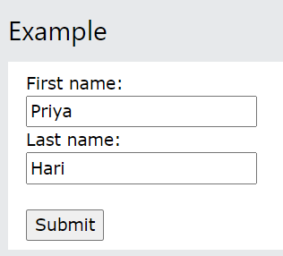
UNIT II * Forms
An HTML form is used to collect user input.
The user input is most often sent to a server for processing.
The elements used in an HTML form are check box, input box, radio buttons, submit buttons etc. Using these elements the information of an user is submitted on a web server.
When the user clicks on the Submit button, the contents of the form is sent to the program that runs on the server.

Slide 2
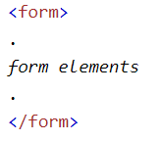
The <form> Element
The HTML <form> element is used to create an HTML form for user input
The <form> element is a container for different types of input elements, such as: text fields, checkboxes, radio buttons, submit buttons, etc..

Slide 3
*Attributes for <form> element
Every <form> element should carry at least two attributes:
action
method

Slide 4
*action attribute
This attribute tells the browser where to send the form content when we submit the form.
Usually the value of the action attribute is a page on a web server that will receive the information.
Eg:
<form action=“http://www.login.html”>
The action attribute in this example sends the data to a file called login. html. The html file process and validates the data and send the result to the browser.

Slide 5
*method attribute
This attribute tells the browser how to send the form content when we submit the form.
This is used to upload the data by using two methods that are Get and Post .
Get Method: -It has a limited length of characters of URL.
Eg: <form action=http://www.login.html method = “get”>
Post Method: -1. It has no size limitations.
Eg: <form action=http://www.login.html method = “post”>

Slide 6
*<input > tag
The <input> element is the most important form element.
It is an example for an empty element.
It allows to add the various type of input fields like button, textbox, radio button etc.
<input> tag is used to define the form controls.
The attribute for the input tag to define the control is type attribute.
Eg: <input type="button">
<input type="checkbox">

Slide 7
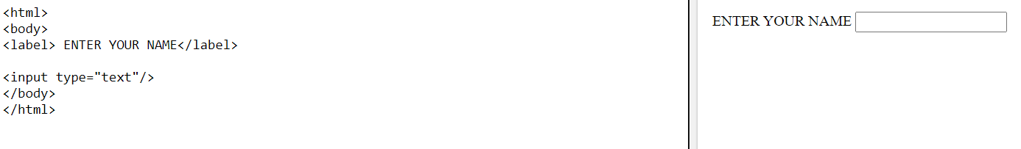
*<label>
The <label> tag is used to provide a descriptive text with its respective form field.
That means it is used to create a caption for an <input> element of a form.
Syntax:
<label> form_content... </label>
Eg:

Slide 8
* Form Controls or fields
A from gets life only when the form controls are added to it and the corresponding actions are provided. The different types of form controls are:
Text Box
Text Area
Password
Buttons – submit & reset buttons
Checkboxes and Radio buttons
Select box
Fieldset and Legend

Slide 9
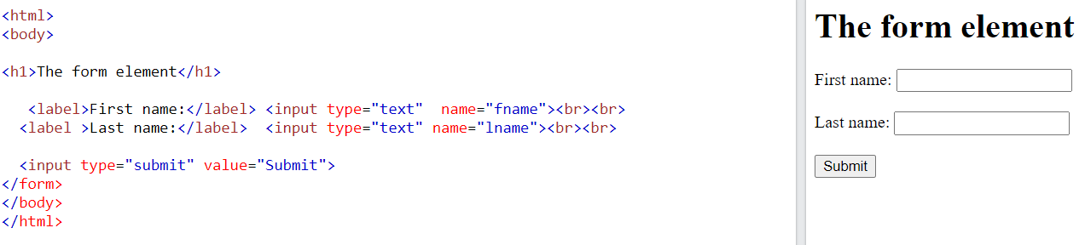
Text Field
It is one of the simplest type of form control.
It is used to enter a single word or a line of text.
It is added to the form using the <input> element with its type attribute set to text.

Slide 10
Here label is the caption for the textbox.
The attribute name is required for identifying the variable name.
By default the browser display a text entry box that is 20 characters wide. But we can change the number of characters using the size attribute.
We can set a maximum character limit using the maxlength attribute.
Eg: <input type=“text” name=“username” maxlength=“50”/>

Slide 11
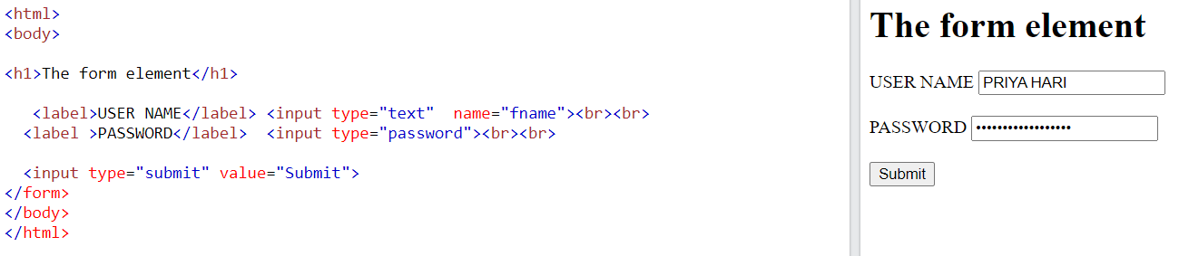
Password field
The <input type="password"> defines a password field (characters are masked).
Syntax:
<input type="password">

Slide 12
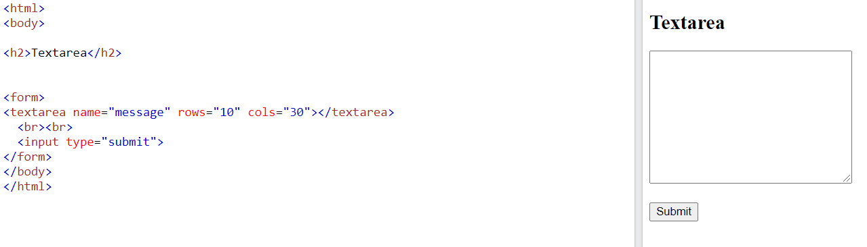
Text Area
Text area is used to enter more than one line of text.
The <textarea> tag in HTML is used to insert multiple-line text in a form.
It is a multi-line scrollable text entry box.
The size of <textarea> can be specify either using "rows" or "cols" .

Slide 13
Buttons
Buttons in HTML is basically of 3 types.
Button
Submit
reset

Slide 14
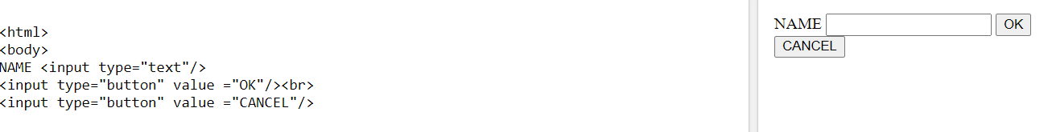
Button
This allows buttons to be included in the form that performs tasks other than submitting or resetting the form.

Slide 15
Submit button
This creates a button that automatically submits a form.
HTML <input type="submit"> are used to add a submit button on web page.
When user clicks on submit button, then form get submit to the server.
Syntax:
<input type="submit" value="submit">
The type = submit , specifying that it is a submit button
The value attribute can be anything which we write on button on web page.

Slide 16
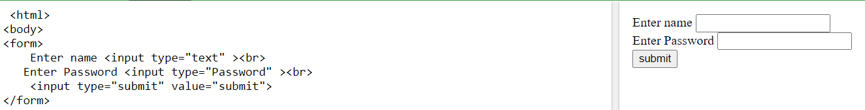

Slide 17
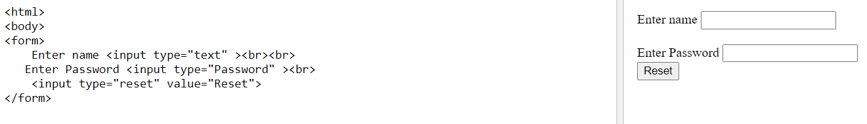
Reset button
This creates a button that automatically resets form controls to their initial values.
That means It is used to reset the filled values of a form to its initial values.
Syntax
<input type =“reset” value =“Reset”/>

Slide 18
checkbox
Checkboxes are added using the <input> element with its type set to check box.
The <input type="checkbox"> defines a checkbox.
The checkbox is a square box that is ticked (checked) when activated.
Checkboxes are used to let a user select one or more options of a limited number of choices. That means user can select multiple options.
Syntax
<input type="checkbox">

Slide 19
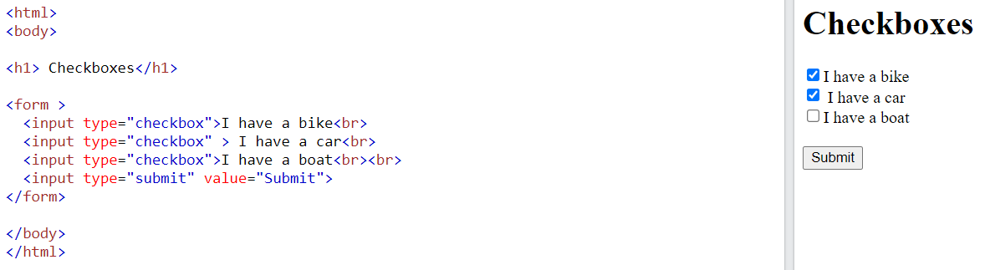

Slide 20
Radio button
The <input type="radio“/> defines a radio button.
Radio button is used to define the small circles, which are highlighted when selected.
It is a form element which allows the users to select only one option from the given set of options.
Syntax
<input type="radio">

Slide 21
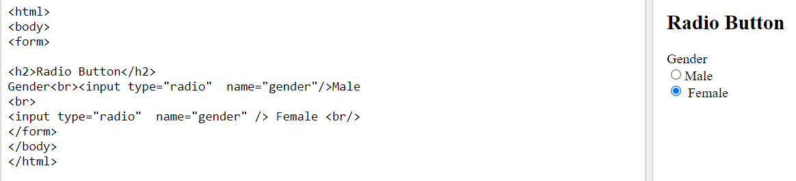

Slide 22
Select Boxes
HTML <select> tag is used to create a drop down list with multiple options.
The <option> element is nested within <select> tag for defining options in a list.
A drop –down select box allows users to select one item from a drop –down menu.
Select boxes will take less space than a group of radio buttons.
Syntax
<select>
<option> </option>
</select>

Slide 23
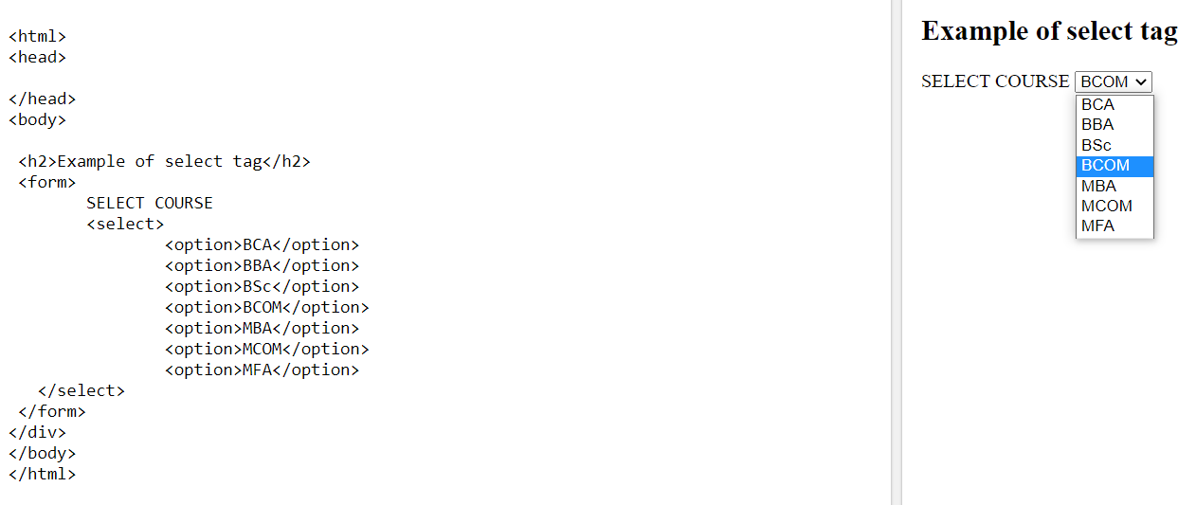

Slide 24
Scrolling Select Box
Using Scrolling select box user can see a few options in a select box and select any one by scrolling down the options.

Slide 25
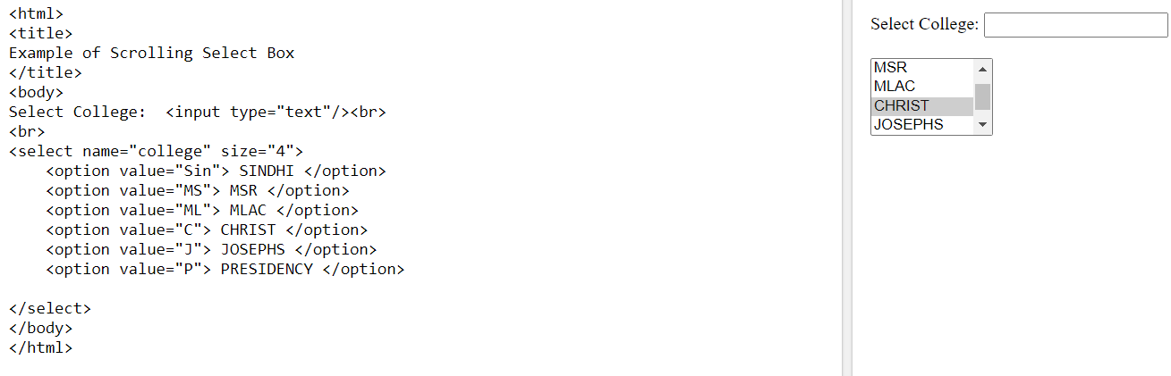

Slide 26
*Fieldset and Legend
The fieldset element is used to logically group a set of form controls.
A fieldset may also contain legend element that provides a caption for the enclosed fields.

Slide 27
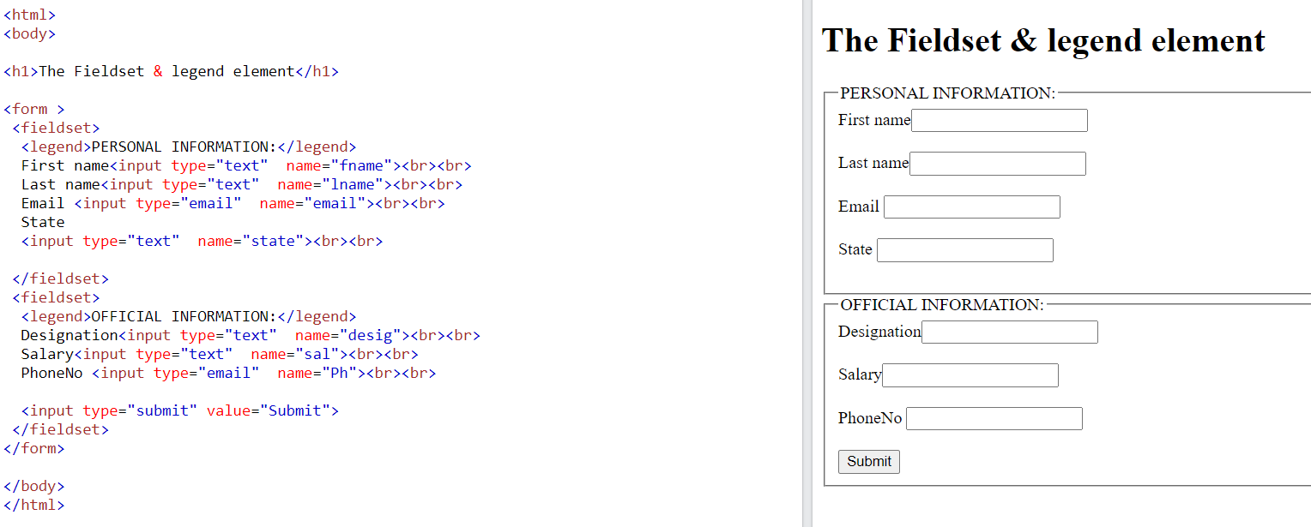

Slide 28
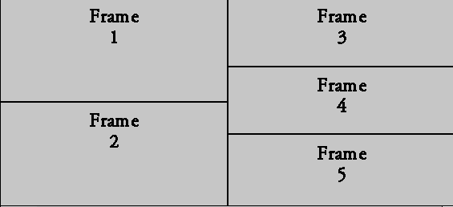
*FRAMES
Frames allow a web page to be divided into several independent sections.
The <frame> tag was used in HTML to define one particular window (frame) within a <frameset>.
A <frame> tag is used with <frameset>, and it divides a webpage into multiple sections or frames.

Slide 29
Syntax
< frame src = "URL" >
*<frameset>
The <frameset> element contains one or more frame elements.
<frameset> is used to specify the number of rows and columns in frameset with their pixel of spaces. .

Slide 30
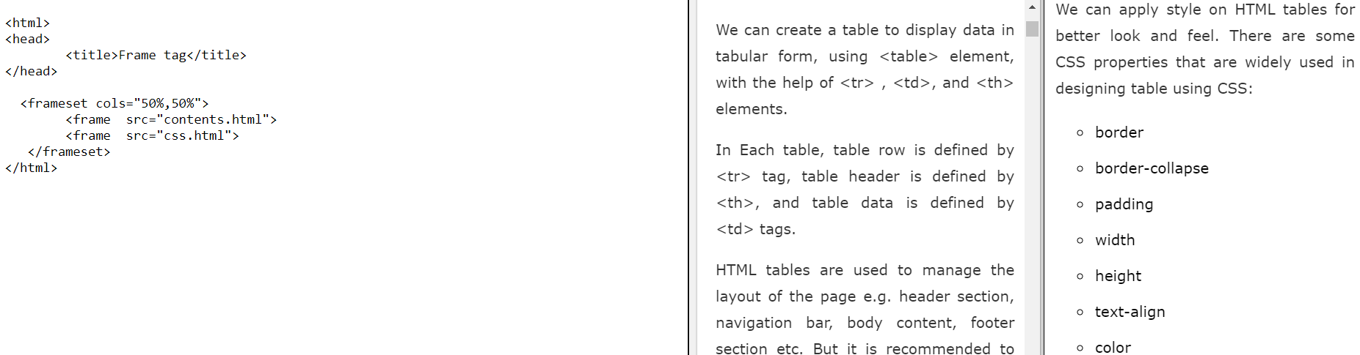

Slide 31
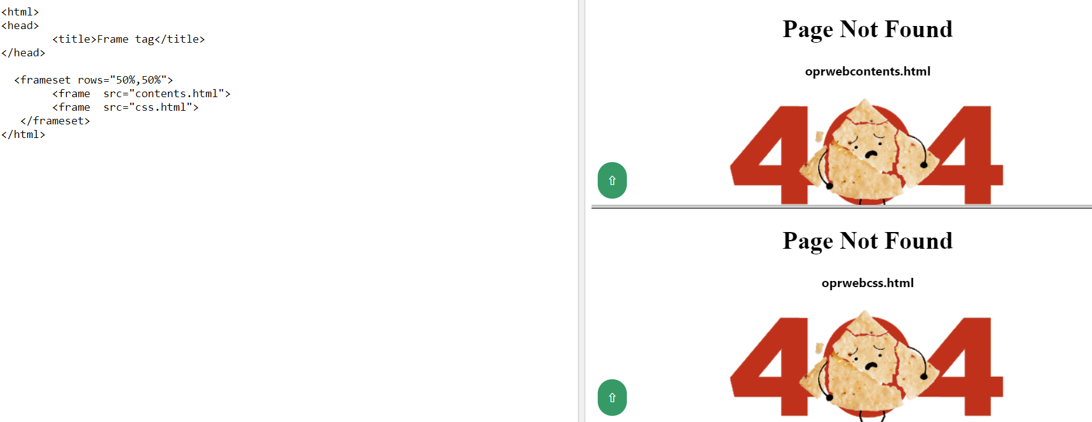

Slide 32
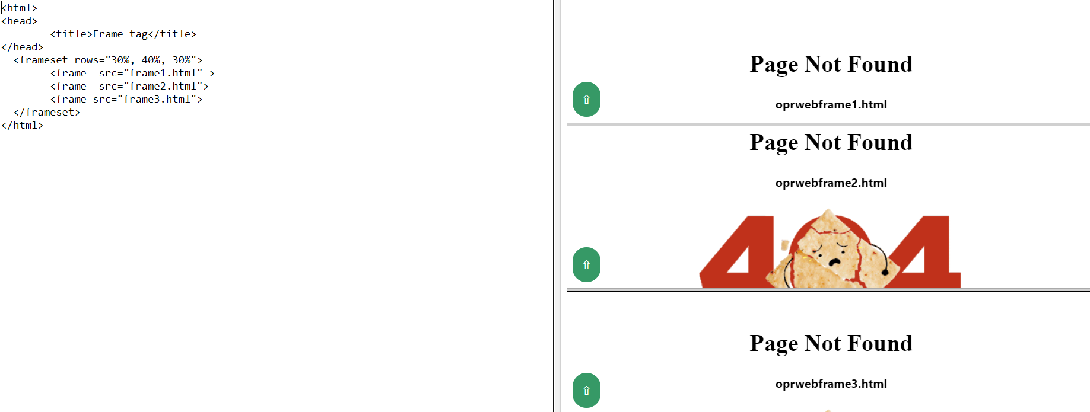

Slide 33
Attributes of <frameset>
cols – specifies how many frames the window will be split into vertically and specifies the width of each frame.
rows - specifies how many frames the window will be split into horizontally and specifies the height of each frame.
3. border
This attribute specifies the width of the border of each frame in pixels. For example, border = "5".

Slide 34
Attributes for the <frame> tag
frameborder – It specifies whether to display a border around the frame or not, and its default value is 1. eg: frameborder=“0” specifies no border.
marginheight- It determines the amount of space above and below the frames.
marginwidth - It determines the amount of space on the sides of the frame.
name – Name of the frame.
norsize - It is used to prevent resizing of the frame by the user.
src- It specifies the URL of the document which we want to display in a frame.

